Slide 1
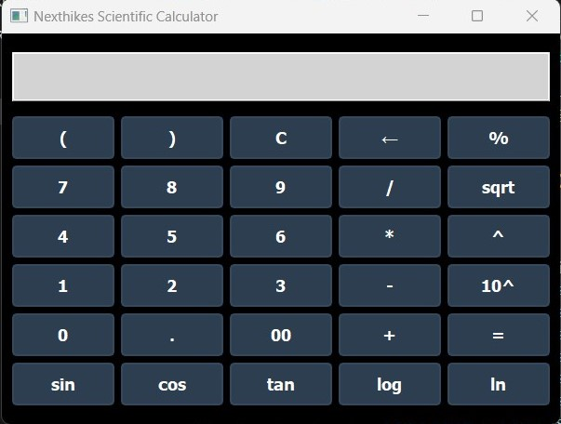
Project -01
NEXT HIKE IT SOLUTIONS
Building a GUI Calculator using Python
Description:
Highlight the application's purpose: To provide accurate and efficient scientific calculations with a modern user interface.
By
Chandra Sekhar Mahanta

Slide 2
Features of the Calculator
Content:
Supports basic arithmetic operations (addition, subtraction, multiplication, division).
Advanced scientific functions like sine (sin), cosine (cos), tangent (tan), logarithms (log, ln), and square root (sqrt).
User-friendly and compact design for easy navigation.
Clear display area for mathematical expressions and results.
By
Chandra Sekhar Mahanta

Slide 3
Visual Interface Design
Description:
Background Color: Dark theme enhances visibility and reduces eye strain.
Buttons: Clearly labeled and color-coded for intuitive operation.
Responsive UI: Adjusts dynamically to accommodate user inputs.
By
Chandra Sekhar Mahanta

Slide 4
Technologies Used
PyQt5 Library: Used for designing the GUI
Python: Back-end logic to handle complex calculations.
Mathematical Libraries: Includes math for precise computation.
By
Chandra Sekhar Mahanta
Description: This calculator is built using open-source tools, ensuring high performance and easy customization.

Slide 5
Benefits of the Calculator
Why Choose This Calculator?
Efficiency: Performs calculations instantly.
Compact Design: Simple layout to minimize confusion
Accessibility: Great for students, professionals, and educators.
Customizable: Can be adapted to add more features or functions.
By
Chandra Sekhar Mahanta

Slide 6
THANK YOU

